Slide 1
Lab 5 String Sorting and Characters Counting

Slide 2
Outline
In Brightspace you are given 1 example program: insertionSort.c
Download from Brightspace the insertionSort.c program.
Open CLion and create a new project called Sort.
Create a new C Source file called: insertionSort.c.
Copy and paste the code contained in the downloaded file: insertionSort.c
Run the program and understand the code by reading the comments and the slides.
This example is useful to tackle Assignment 1
insertionSort.c
It is a program that sorts 5 strings provided as input from the command line

Slide 3
Outline
In Brightspace you are given 1 example program: charCount.c.
Download from Brightspace the charCount.c program.
Create a new project in CLion.
Create a new C Source file called: charCount.c.
Copy and paste the code contained in the downloaded file: charCount.c
Run the program and understand the code by reading the comments and the slides.
These examples are useful to tackle Assignment 1
charCount.c
It is a module that counts the number of occurrences of each character in the string.

Slide 4
insertionSort.c

Slide 5
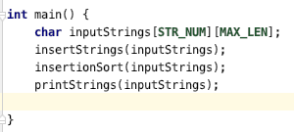
insertionSort.c
insertStrings:
reads 5 strings from the standard input and writes them in inputStrings
insertionSort:
Sorts the strings in inputStrings in alphabetical order using the insertion sort algorithm
printStrings:
Prints the strings stored in inputStrings

Slide 6
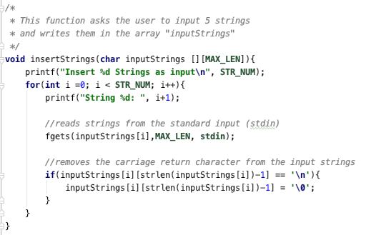
insertStrings
Asks the user to input 5 strings and writes them in the 2D array “inputStrings”

Slide 7
insertStrings
Function fgets is used to read from the standard input (stdin)
To refer to variable stdin, you need to include library stdlib.h

Slide 8
insertStrings
It is important to remove the ‘\n’ character at the end of the string to avoid problems during printing and sorting.

Slide 9
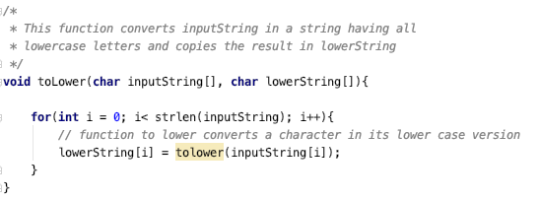
toLower
Converts a string provided as input to lowercase characters and writes the result into lowerString

Slide 10
toLower
For each character in the string it applies the C function toLower that converts each character into lower case letters.
To use C function toLower you need to include library ctype.h

Slide 11
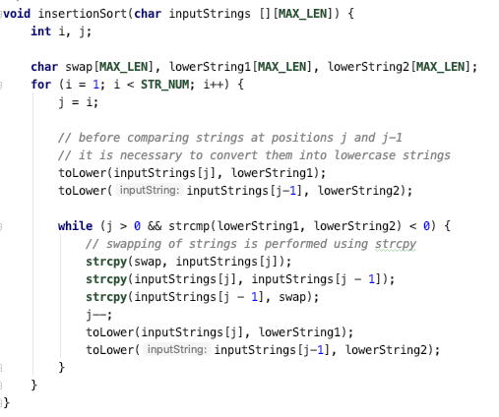
insertionSort
Sorts the strings provided as input

Slide 12
insertionSort
Before comparing strings, it converts them to lower case letters.

Slide 13
insertionSort
Strings swapping is performed using function strcpy

Slide 14
insertionSort
Decrements j and converts the strings to lower case letters before comparing them in the next cycle of the while loop.

Slide 15
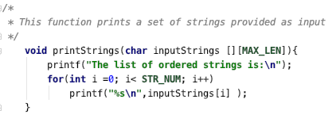
printStrings
Prints the sorted array of strings.

Slide 16
charCount.c

Slide 17
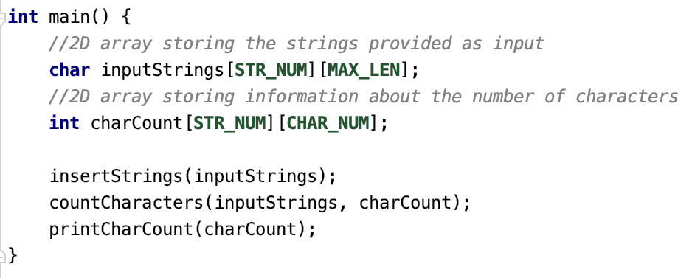
charCount.c
inputStrings
A 2Dimensional array of characters storing the strings provided as input
charCount
A 2Dimensional array of integers storing the number of characters contained in the strings in inputStrings

Slide 18
charCount.c
insertStrings:
reads 5 strings from the standard input and writes them in inputStrings.
countCharacters:
Counts the number of characters for the strings in inputStrings and stores the results in charCount.
printCharCount:
Prints the number of characters in the sentences in inputStrings

Slide 19
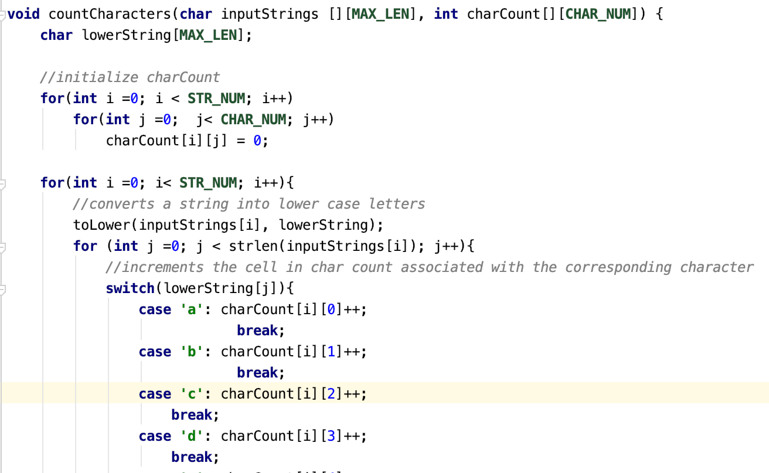
countCharacters

Slide 20
countCharacters
Initialize the 2D array of integers storing the characters count.

Slide 21
countCharacters
Converts a string into lower case characters

Slide 22
countCharacters
Increments an element of the array corresponding to the row of the string considered and the column of the character encountered.

Slide 23
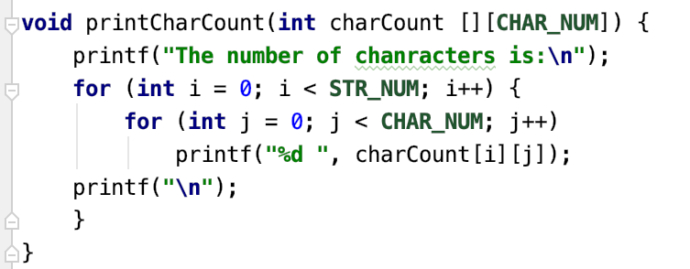
countCharacters
Prints the number of characters in the string provided as input (stored in charCount).

